Slide 1
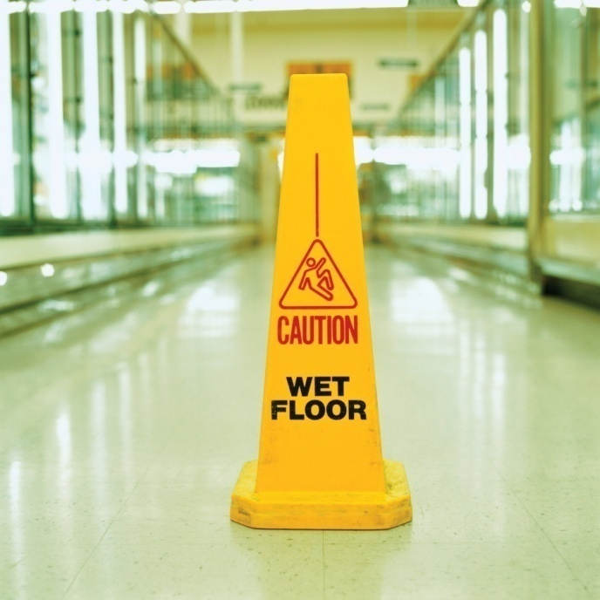
Slip trip and fall (STF) prevention
A scientific approach
November 17th, 2017
Adam Thomas, CXLT, ARM, AINS, CHCM
Senior Risk Engineering Consultant
Zurich Risk Engineering
Notes:
Welcome to Slip, trip and fall prevention - Zurich’s 10-point program approach. The purpose of this webinar is to review with you the importance of slip, trip and fall prevention, not only from a General Liability viewpoint, but also from a Workers Compensation perspective.

Slide 2
Objectives
This presentation is designed to provide:
  An understanding of the importance of STF assessments
  An overview on how to utilize the Zurich 10-point STF assessment program
  Insight on the major risk factors that cause or contribute to STF accidents
  An understanding of the value tribometry provides to the STF assessment process
Notes:
By the end of this session, each participant will be able to:
Understand the importance of slip and fall assessments
Understand the Zurich 10-point assessment model
Describe the major risk factors that cause or contribute to slip, trip and fall accidents
Conduct slip, trip and fall assessments using the Zurich 10-point assessment program

Slide 3
Why perform a STF assessment?
STF is one of the leading causes of injuries for workers and third parties
  Falls account for over 8 million hospital emergency room visits, representing the leading cause of visits (21.3%). Slips and falls account for over 1 million visits, or 12% of total falls. (Per year)
  Average WC claim cost: $25,000 - $28,000
  According to the Consumer Product Safety Commission (CPSC), floors and flooring materials contribute directly to more than 2 million fall injuries each year.
  Half of all accidental deaths in the home are caused by a fall. Most fall injuries in the home happen at ground level, not from an elevation.
Source: Centers for Disease Control and Prevention, National Center for Injury Prevention and control. Web-based Injury Statistics Query and Reporting System (WISQARS) [online]. Accessed November 1, 2010. http://webappa.cdc.gov/cgi-bin/broker.exe

Slide 4
Why perform a STF assessment?
STF incident costs increasing
Soaring medical costs
Litigation/litigious markets
Fraud
Aging population/longer recovery times
Population 65+ to double next 20 years
Reducing STF claims adds significant dollars to the bottom line
Source: CDC: U.S. senior-citizen population to double by 2030. USA Today.Com, Health and Behavior, February 3, 2003.
Notes:
STF incident costs are increasing. Soaring medical costs, litigation and fraud are driving up the costs of claims considerably each year.
We also have an aging population. Aging workers and aging customers who slip, trip or fall require significantly more recovery time, if they recover. There are many hidden costs associated with slip, trip and fall injuries. The fact that our population 65 and older is going to double over the next 20 years is a very significant factor to consider and prepare for. Reducing STF claims will add significant dollars to the bottom line, especially in the years to come.

Slide 5
Zurich’s 10-point STF Approach
Developed using a forensic approach
Convergence of the following 10 risk factors
Obstructions
Visibility
Stairs
Human factors
Unusual features
Surface composition
Foreign substance potential
Surface condition
Surface changes
Level changes
Notes:
The Zurich 10-point program was developed as a result of a forensic review of a large number of slip, trip and fall injury cases.
This review identified common risk factors that cause or contribute to slips, trips and falls. The convergence of two or more of these risk factors increases the potential for an incident.

Slide 6
Foreign substance
potential
Surface
composition
Surface condition
Unusual features
Surface changes
STF
Human factors
Level changes
Stairs
Obstructions
Visibility
Notes:
One contributing factor does not usually cause a slip, trip and fall incident. It takes a combination of factors to result in an incident. An example of this interaction of factors could be an older person with progressive bi-focal glasses walking down a dimly lit stairwell and missing the bottom step and falling. The contributing factors would be visibility - dimly lit stairs, human factors - glasses and age.

Slide 7
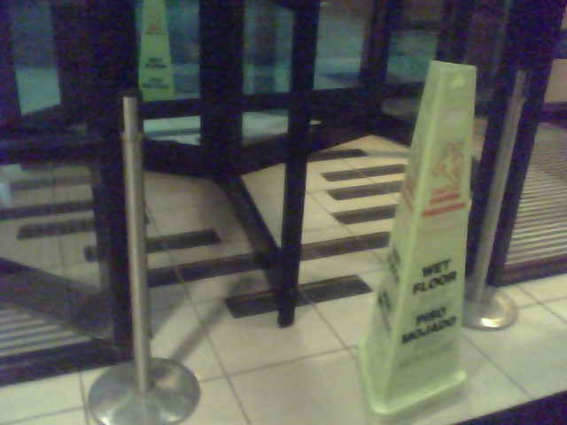
STF Risk Factor 1 – Surface composition
Type of walking/working surface, interior or exterior
  Vinyl composition tile (VCT), carpet, marble terrazzo, asphalt, cement, wood, etc.
Suitability for use/environment
Notes:
Surface composition is the type of material that makes up the walking/working surface. Some examples of surface composition are VCT-Vinyl Composition Tile, (80% of interior walking surfaces are VCT), marble as pictured, carpet, terrazzo, asphalt, cement, wood, etc.
The marble surface pictured is a great example of a smooth, hard, shiny surface that is safe, when dry, but cannot be safely used when wet. This business owner, and many others, are on high alert every time there is inclement weather.
Permission to use photo 3/25/2011:
Kelly,
Thank you for the helpful information. Please feel free to use the picture of the front entrance as long as the hotel is not specifically identified. Thanks to for continuing to stay with us.
Bruce Roy
Regional Director of Operations
CAM Hospitality Management, LLC.
Radisson Hotel Pittsburgh
101 Radisson Drive
Pittsburgh, PA 15205
412-920- 8091 (Direct)
412-922-7854 (Fax)
412-922-8400 (Hotel)
1-800-333-3333 (Reservations)
412-310-8571 (Mobile)
www.radisson.com/pittsburghpa_greentree
www.camhospitality.com

Slide 8
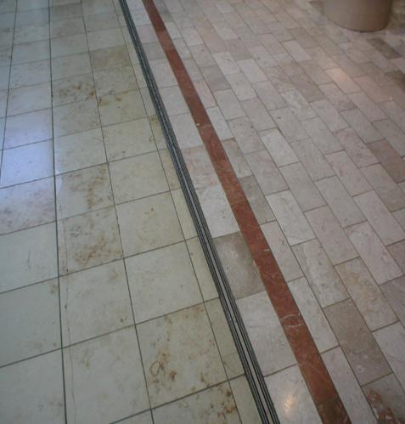
STF Risk Factor 1 – Surface composition
Coefficient of friction - dry
Slip resistance - wet
Surface asperities or roughness enhance COF or slip resistance
Most surfaces are safe when clean and dry
Basic facts: Clean, smooth, hard surfaces are safe when dry, but very unsafe when wet. Similar slip resistance to ice
ASTM F1637.10
  Exterior walking surfaces shall be slip resistant
  Interior walking surfaces that are not slip
  resistant shall be maintained dry
Don’t forget about your own residence
Notes:
You will hear the term coefficient of friction-(dry surfaces) or slip resistance-(wet surfaces) used when evaluating floor safety. It is important to have an understanding of this concept. As mentioned, clean, smooth, shiny, hard surfaces are safe, when dry, but very slippery when wet.
Surface asperities or roughness enhance coefficient of friction or slip resistance. Current standards used to test floor surfaces and related products, UL 410-Slip resistance of Floor Surface Materials and ASTM D2047-Standard Test Method for Static Coefficient of Friction of Polished-Coated Flooring Surfaces as Measured by the James Machine, only test clean dry products under laboratory conditions. A Coefficient of Friction rating of .50, when dry, will pass. As stated, clean dry surfaces are typically safe. The marble floor pictured will test well above the .50 standard. When wet, the marble tile will test similar to ice and be very slippery.
In order to improve walking/working surfaces, many decision makers need to be educated and safer walking surfaces installed with new projects or remodels. The biggest opportunities to improve surface composition are at facility entrances, normally wet areas of manufacturing plants and warehouses, kitchens, restaurant dining areas, restrooms, break rooms, hotel shower pans and bathtubs, bathroom floors, locker room floors, showers, etc.
A basic rule covered in ASTM F1637.10, Standard Practice for Safe Walking Surfaces, would be that all exterior walking surfaces be slip resistant. Interior walking surfaces that are not slip resistant must be maintained dry while the building is occupied.
Also, don’t forget about your personal residence next time you build a house or renovate an area with a current slippery surface that could be made safer.
-Picture provided courtesy of Diana Hoover, Lord & Taylor. Customized entrance matting manufactured by Callas Enterprises. Permission to use photos email on file. See below.
December 8, 2009
Hi Kelly,
Good to hear from you!
You may have our permission to use the photos. If possible, please try not
to include any shots which would show our Logo or anything brand specific -
which I assume they don't ...... but just want to mention.
Thanks & have a wonderful holiday season!
Diana

Slide 9
STF Risk Factor 1 – Surface composition
Tribometry: Science of measuring slip resistance / shoe traction properties on walking /working surfaces, using a slip meter
Slip meters must avoid sticktion in order to be used on wet surfaces
Sticktion: Inability to test wet surfaces properly
  Unit takes additional time to complete test stroke
  Results in higher readings
Must have properties similar to human ambulation
  Horizontal and vertical/normal movement simultaneously
  Similar to a human ankle
Notes:
Tribometry is the science of measuring slip resistance/shoe traction properties on walking /working surfaces using a slip meter. In order to provide credible readings slip meters must avoid sticktion. Sticktion is the inability to test wet surfaces properly. The slip meter takes additional time to complete a test stroke, commonly referred to as residence time. This results in higher readings. Wet surfaces in most cases will test safer than dry surfaces. In order for a slip meter to be used on wet surfaces, it must have properties similar to human ambulation. Horizontal and vertical/normal movement simultaneously, similar to a human ankle.
When filling out this section of the 10-point program, determine if surface composition is a Very Low, Low, Medium or High exposure for a slip, trip or fall. Rate each surface composition you evaluate appropriately as surface composition is the most critical factor in controlling slips, trips and falls.

Slide 10
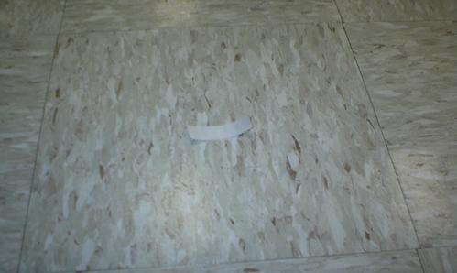
STF Risk Factor 2 – Foreign substance potential
Likelihood of foreign substance
  Water, oil, various contaminates, debris, etc.
  Commonly referred to as lubricants
Rate effect of foreign substance on surface being evaluated
Spill controls
  Cleanup measures (effectiveness)
  Barricades and signage
Tracking effect (under shoes)
  Example: grease from a kitchen
  Proper cleaning protocols ?
  Avoiding polymerization?
Notes:
Foreign substance potential is the likelihood of a contaminant or debris being on the walking/working surface. Foreign substances on a surface lead to slips, trips and falls. Spill controls are critical to reducing foreign substance potential. These controls include clean up measures, barricades and signage to warn people that the floor is wet or contaminated. The “tracking effect”-tracking substances, such as grease, on shoes can lead to the substance being spread, such as grease from a kitchen. Proper cleaning protocols must be followed to keep floors safe. The proper degreaser, hot or cold water as specified, aggressive cleaning with a bristle broom and the commitment to remove the dirty water from the surface are needed to avoid polymerization. Polymerization is the accumulation of minerals and grease onto a kitchen or dining room floor. If dirt and grease are not removed properly and only swabbed around on the floor, the floor will appear clean but be very slippery when wet due to the loss of asperities or surface roughness. Basically the surface roughness will be filled in with dirt and grease, reducing the available friction.
Determine the likelihood that a foreign substance will adversely affect the slip resistance of each walking surface evaluated and score appropriately.
Permission to use photos from Allen Wingfield, Big Lots, Inc.
Yes, it will be fine.
-------------------------------------------------------------------------------------------------------------------------------------------------------------------
Most accidents are a consequence of unsafe behavior. Change the behavior and you will reduce accidents
-------------------------------------------------------------------------------------------------------------------------------------------------------------------
Allen Wingfield
Manager Risk Management
Big Lots Inc.
Phone 614-278-7205
Fax 614-278-7218
e-mail allenwingfield@biglots.com
This communication is confidential and may contain privileged information intended solely for the named addressee(s). It may not be used or disclosed except for the purpose for which it has been sent. If you are not the intended recipient, you must not copy, distribute or take any action in reliance on it. Unless expressly stated, opinions in this message are those of the individual sender and not of Big Lots. If you have received this communication in error, please notify Big Lots by emailing postmaster@biglots.com quoting the sender and delete the message and any attached documents. Big Lots accepts no liability or responsibility for any onward transmission or use of emails and attachments having left the Big Lots domain.
Kelly Brown <kelly.brown@zurichna.com>
12/07/2009 01:35 PM
To
allenwingfield@biglots.com
cc
Kelly Brown <kelly.brown@zurichna.com>
Subject
Permission to Use Pictures
Allen:
I hope all is well.
I am putting together another slip, trip and fall prevention training
program for Zurich. I would like to use pictures I took of the York store
entrance matting and a stairway in the presentation.
Would you mind giving me permission to use those two pictures?
Thanks,
Kelly Brown
Sr. Risk Engineering Consultant
Retail/Wholesale Industry Practice Leader
(717) 747-5545-Office
(717) 226-1956-Cell
Email: Kelly.brown@zurichna.com
Zurich Services Corporation

Slide 11
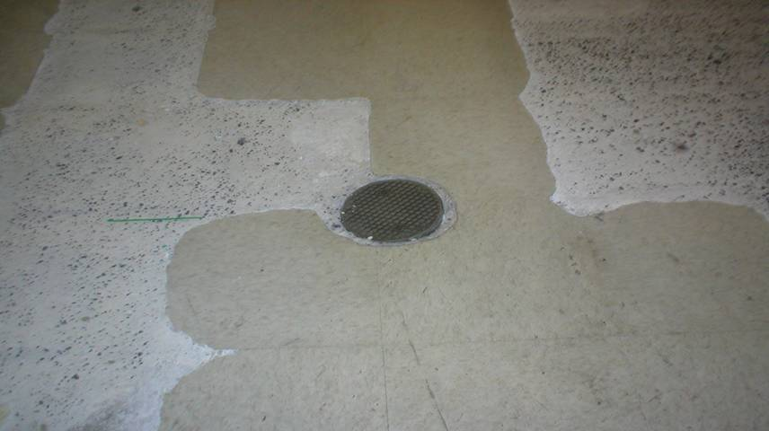
STF Risk Factor 3 – Surface condition
Maintenance
Loose carpet
Broken tile
Pot holes
Notes:
Surface condition is related primarily to the maintenance and current condition of the walking/working surface. Defects could include loose carpet, broken tiles, pot holes, etc.
While the surface composition may be adequate for the environment if it is not properly maintained (in good condition), it could lead to a slip, trip or fall hazard.
Rate surface conditions appropriately. Post warning signs or barricade the exposure, if necessary to prevent an incident.
Permission to use photos from Allen Wingfield, Big Lots, Inc.
Yes, it will be fine.
-------------------------------------------------------------------------------------------------------------------------------------------------------------------
Most accidents are a consequence of unsafe behavior. Change the behavior and you will reduce accidents
-------------------------------------------------------------------------------------------------------------------------------------------------------------------
Allen Wingfield
Manager Risk Management
Big Lots Inc.
Phone 614-278-7205
Fax 614-278-7218
e-mail allenwingfield@biglots.com
This communication is confidential and may contain privileged information intended solely for the named addressee(s). It may not be used or disclosed except for the purpose for which it has been sent. If you are not the intended recipient, you must not copy, distribute or take any action in reliance on it. Unless expressly stated, opinions in this message are those of the individual sender and not of Big Lots. If you have received this communication in error, please notify Big Lots by emailing postmaster@biglots.com quoting the sender and delete the message and any attached documents. Big Lots accepts no liability or responsibility for any onward transmission or use of emails and attachments having left the Big Lots domain.
Kelly Brown <kelly.brown@zurichna.com>
12/07/2009 01:35 PM
To
allenwingfield@biglots.com
cc
Kelly Brown <kelly.brown@zurichna.com>
Subject
Permission to Use Pictures

Slide 12
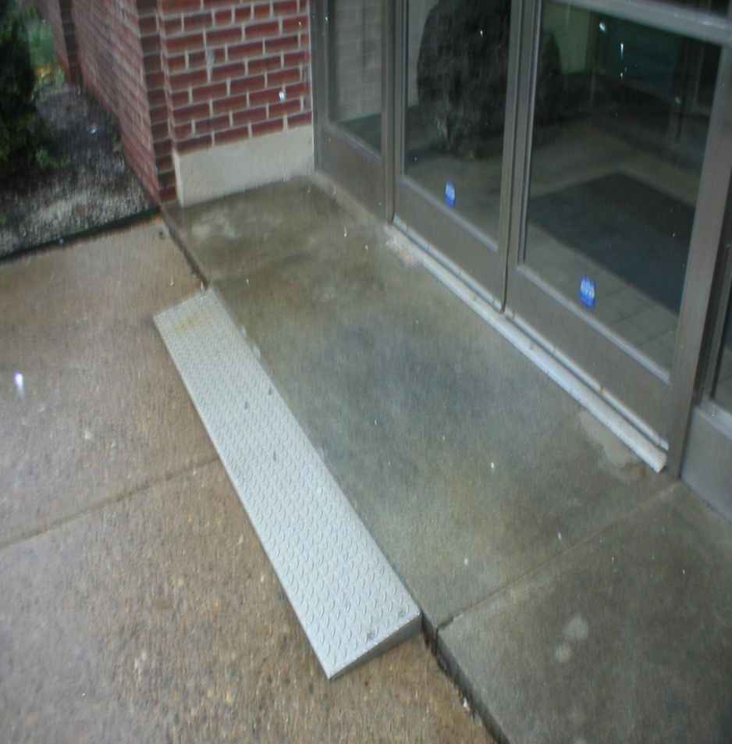
STF Risk Factor 4 – Surface changes
Frequent changes in types of flooring
High traction to low traction
Low traction to high traction
Notes:
Surface changes involve transitioning to different surface types. The most common example would be transitioning from a wet sidewalk to a vestibule with VCT –Vinyl Composition Tile or other smooth, hard surface. Or from an entrance mat to VCT. High traction to low traction surfaces causes most slips and falls. Low traction to high traction can possibly cause a trip or stumble, if the pedestrian does not adjust their gait.
Surface changes in a walking pathway with big differences in traction should be rated accordingly.
Permission to use photos.
Kelly: no problem- go ahead and use the photos.
bk
He that by the plough would thrive,
Himself must either hold or drive
Ben Franklin

Slide 13
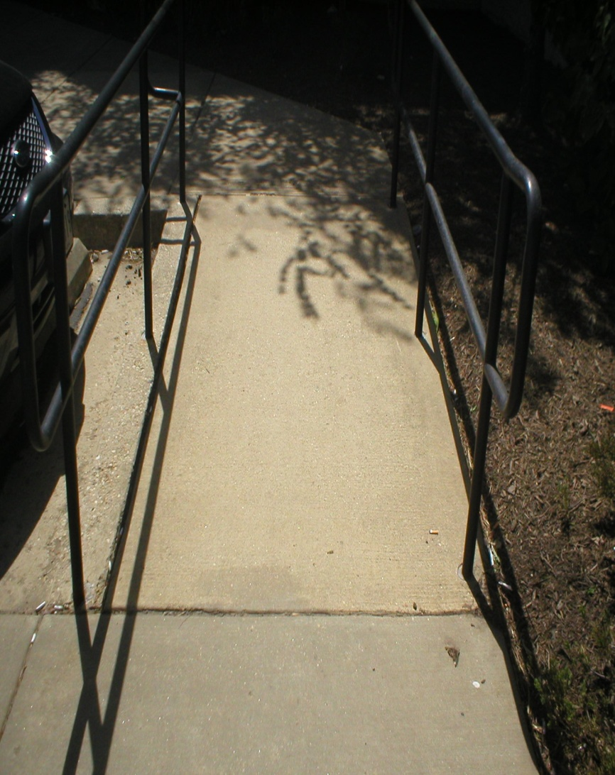
STF Risk Factor 5 – Level changes
Three or fewer steps
Frequency of level changes
Small and subtle changes
Ramps
Non-uniform steps
Notes:
Level changes are 3 or fewer steps, ramps and other sloping floor areas. Three or more steps are considered stairs. Subtle changes such as thresholds and non-uniform steps can all result in slips, trips and falls. All level changes should have a visual cue for the person walking.
Look for unusual level changes that may not be to local building codes, such as customized door thresholds, steps or stairs, ramps, etc.
Rate all level changes accordingly.
Permission to use photo. Diana Hoover, Lord & Taylor. December 8, 2009 email on file.
Hi Kelly,
Good to hear from you!
You may have our permission to use the photos. If possible, please try not
to include any shots which would show our Logo or anything brand specific -
which I assume they don't ...... but just want to mention.
Thanks & have a wonderful holiday season!
Diana
Items such as multiple level changes, non-uniform steps and ramps with excessive slope should be given a low number rating.

Slide 14
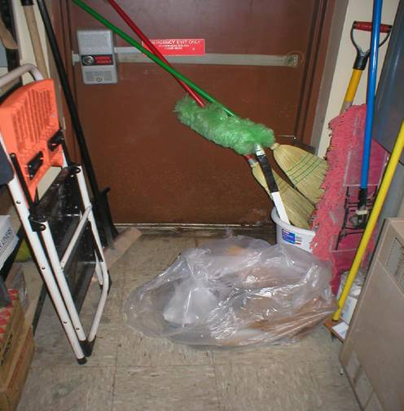
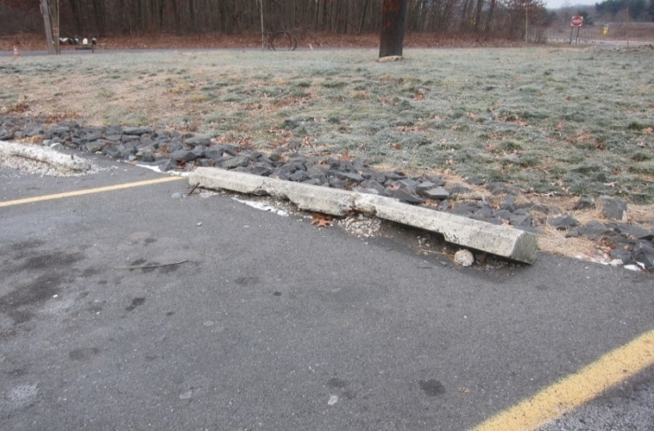
STF Risk Factor 6 – Obstructions
Temporary
  Electrical cords, pipes, hoses
  Clutter, housekeeping
  Tools, material, supplies
Permanent
  Parking wheel stops
  Curbing/speed bumps
Notes:
Obstructions can be anything that impedes walking patterns and contribute to the likelihood of a slip, trip or fall. They can be decorative such as a planter, temporary such as boxes or clutter or permanent such as parking lot wheel stops or curbing.
Factors to consider in an evaluation include the proximity to traffic areas and the permanency of the item. Familiarity with the area or obstructions is a positive factor for some and a very negative factor for others.
Look for wheel stops that have been pushed out of place or damaged as a result of snow removal. Also, look for wheel stops installed directly in front of curbing. Wheel stops are a significant obstruction and cause of loss when looking at loss data for workers compensation and general liability.
Curbing that is above six inches and speed bumps above four inches in height can be a significant cause of serious trip and fall incidents.
Poor housekeeping, clutter and obvious or hazardous obstructions should be rated as a high exposure.
Permission to use photo on right from Allen Wingfield, Big Lots, Inc.
Yes, it will be fine.
-------------------------------------------------------------------------------------------------------------------------------------------------------------------
Most accidents are a consequence of unsafe behavior. Change the behavior and you will reduce accidents
-------------------------------------------------------------------------------------------------------------------------------------------------------------------
Allen Wingfield
Manager Risk Management
Big Lots Inc.
Phone 614-278-7205
Fax 614-278-7218
e-mail allenwingfield@biglots.com
This communication is confidential and may contain privileged information intended solely for the named addressee(s). It may not be used or disclosed except for the purpose for which it has been sent. If you are not the intended recipient, you must not copy, distribute or take any action in reliance on it. Unless expressly stated, opinions in this message are those of the individual sender and not of Big Lots. If you have received this communication in error, please notify Big Lots by emailing postmaster@biglots.com quoting the sender and delete the message and any attached documents. Big Lots accepts no liability or responsibility for any onward transmission or use of emails and attachments having left the Big Lots domain.
Kelly Brown <kelly.brown@zurichna.com>
12/07/2009 01:35 PM
To
allenwingfield@biglots.com
cc
Kelly Brown <kelly.brown@zurichna.com>
Subject
Permission to Use Pictures

Slide 15
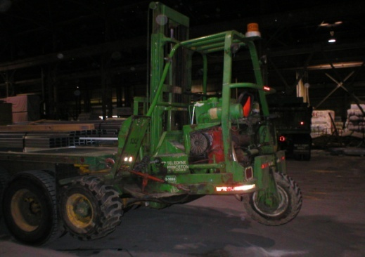
STF Risk Factor 7 – Visibility
More than just illumination or lighting
Consideration during an evaluation should include:
  Glare and lack of color contrasts
Poor visibility increases the adverse impact of surface/level changes and obstructions
Business owners should draw attention to level changes by:
  Using color contrasts
  Marking step or stair nosings
  Use of reflective or contrasting colors
  Marker lights or spot lighting
  Use of signage
    “Watch your step”
    “Please use handrail”
Notes:
Visibility is more than just lighting. Consideration during an evaluation should include glare and the lack of color contrasts. Poor visibility increases the adverse impact of surface/level changes and obstructions.
Business owners should draw attention to level changes by:
Using color contrasts
Marking step or stair nosings
Use of reflective or contrasting colors
Marker lights or spot lighting
Use of signage
“Watch your step”
“Please use handrail”
Poor visibility creates a high exposure to a slip, trip or fall incident and should be rated accordingly.
Kelly: no problem- go ahead and use the photos.
bk
He that by the plough would thrive,
Himself must either hold or drive
Ben Franklin

Slide 16
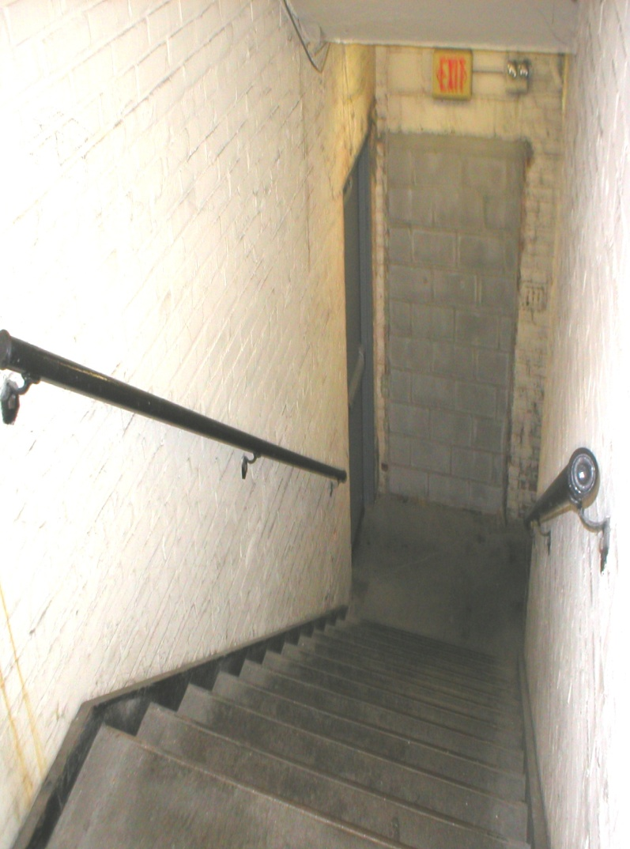
STF Risk Factor 8 – Stairs
More than 3 steps
Frequency and type of use
Uneven stair geometry-3/16” to 3/8”
  Runner 9 to10” existing, 11”new
  Risers-8”existing, 7” new
  Landings
  Treads-slip resistant
  Slope angle-30 to 35 degrees
High risk stairs
  Non-uniform steps
  Worn or loose nosing, coverings
  Wide with no reachable/graspable railing
Handrails – shape-too big to grasp?
Notes:
Stairs are defined as more than three steps. Consider frequency of use, whether they are for emergency only, etc. Curved or spiral stairs would receive a lower rating. Also consider handrails and maintenance. Handrails that are too large in diameter do not permit pedestrians to grip the handrails properly. Escalators and elevators, if any, also need to be considered.
Kelly: no problem- go ahead and use the photos.

Slide 17
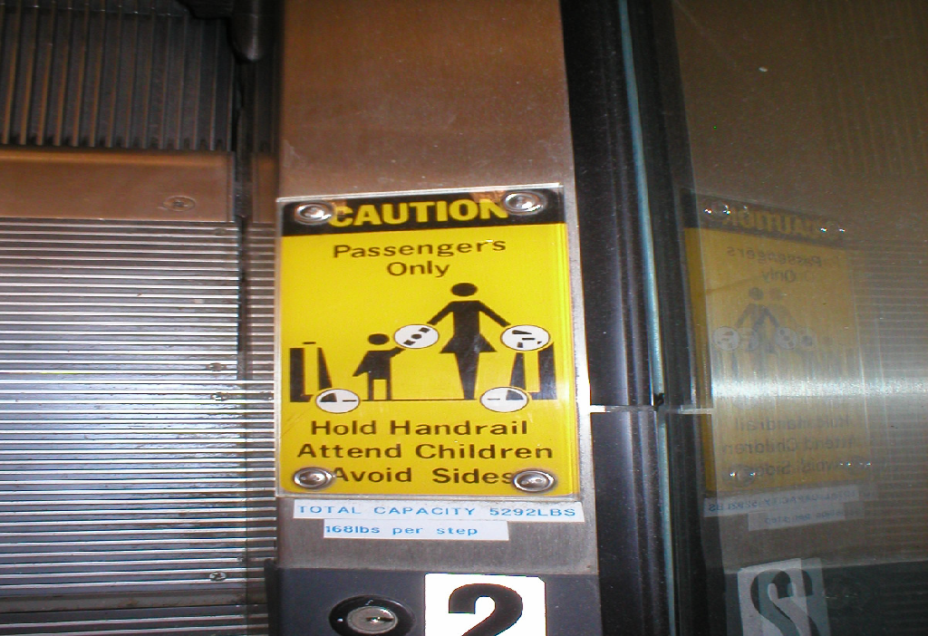
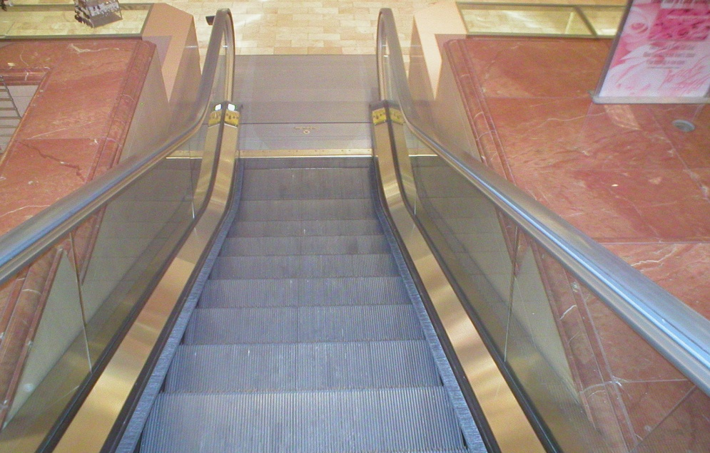
STF Risk Factor 8 – Stairs
When not operating, escalator steps do not generally meet the standard step geometry for stairs.
Businesses with escalators should have additional controls in place
Notes:
When not operating, escalator steps do not generally meet the standard step geometry for stairs.
Businesses with escalators should have additional controls in place. Patrons with strollers, wheelchairs, walkers or those having trouble boarding should be directed to the public elevator. Managers or employees with keys to the escalators should be readily available to turn escalators back on or react to defects when units malfunction and need to be turned off or taken out of service until properly repaired.
Warnings are effective controls in some applications, such as this warning sign recommended for escalators. Warning signs should be installed on both sides of the Up/Down escalators. Signs should communicate- No Strollers, Face Forward, Use Handrail and Hold Child's Hand while riding.

Slide 18
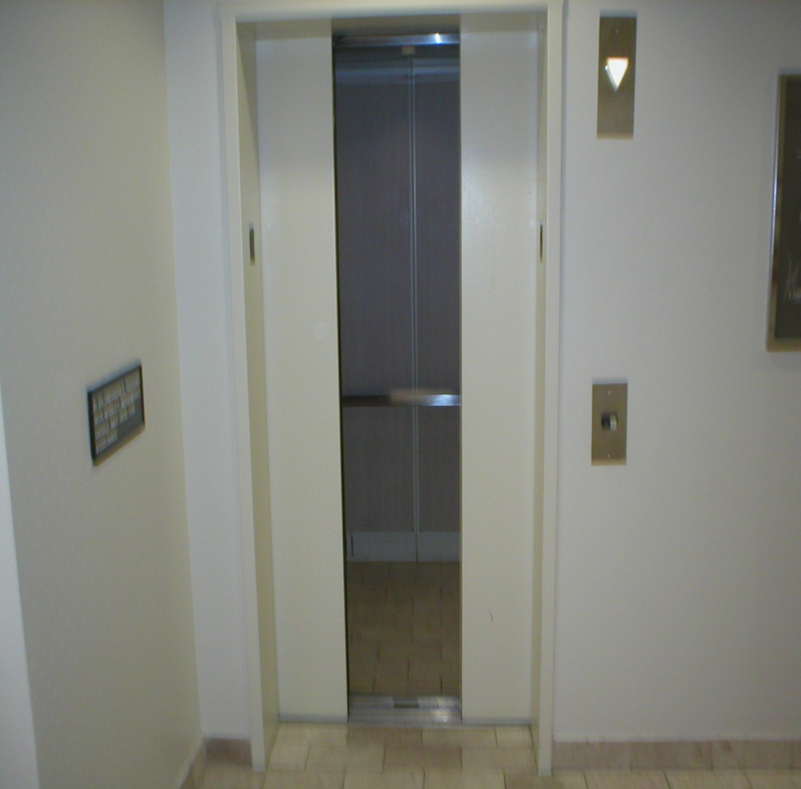
STF Risk Factor 8 – Stairs
Elevator carriages should be level with the floor at all floor stops to prevent tripping incidents.
Elevator carriage floors and door thresholds should be slip resistant.
Changes in floor surfaces from each floor to elevator should be clearly visible.
Notes:
Elevator carriages should be level with the floor at all floor stops to prevent tripping incidents.
Elevator carriage floors and door thresholds should be slip resistant.
Changes in floor surfaces from each floor to elevator should be clearly visible.
Permission to use photos.
Hi Kelly,
Good to hear from you!
You may have our permission to use the photos. If possible, please try not
to include any shots which would show our Logo or anything brand specific -
which I assume they don't ...... but just want to mention.
Thanks & have a wonderful holiday season!
Diana
Diana Hoover • Legal Administrator
Lord & Taylor • 250 Highland Park Blvd.• Wilkes-Barre, PA 18702
phone (570-821-6435) fax (570-821-6335) email
Diana_Hoover@LordAndTaylor.com

Slide 19
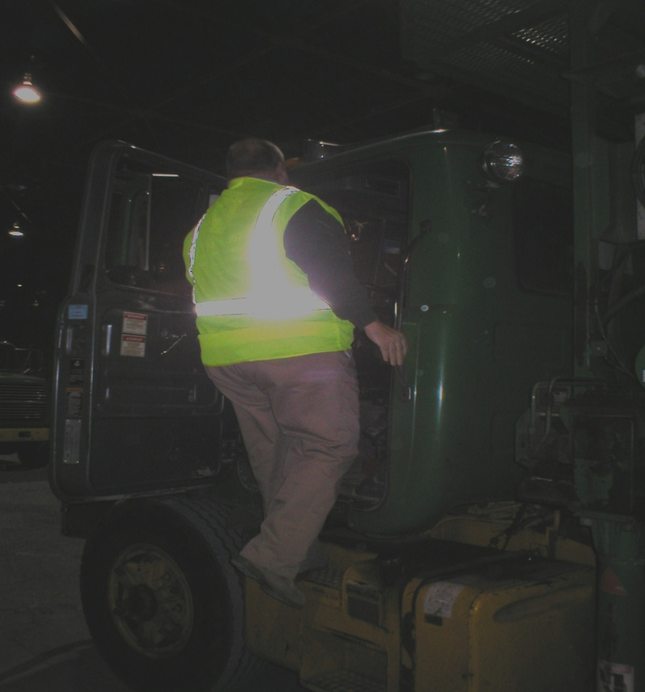
STF Risk Factor 9 - Human Factors
Age
Shoes
Vision
Physical, mental state
Cumbersome objects/packages
Notes:
The assumption is that different people have different physical capabilities. Human factors are elements such as age of expected traffic, shoe types, familiarity with the areas traveled, and physically challenged persons or their mental state such as being tired, pre-occupied, or fatigued. Other items to consider include crowds, people taking short cuts, people on medications or intoxication.
Carrying awkward packages/materials can also negatively affect the rating. Give proper ratings to those areas where human factors play a critical negative factor.
Kelly: no problem- go ahead and use the photos.
bk
He that by the plough would thrive,
Himself must either hold or drive
Ben Franklin

Slide 20
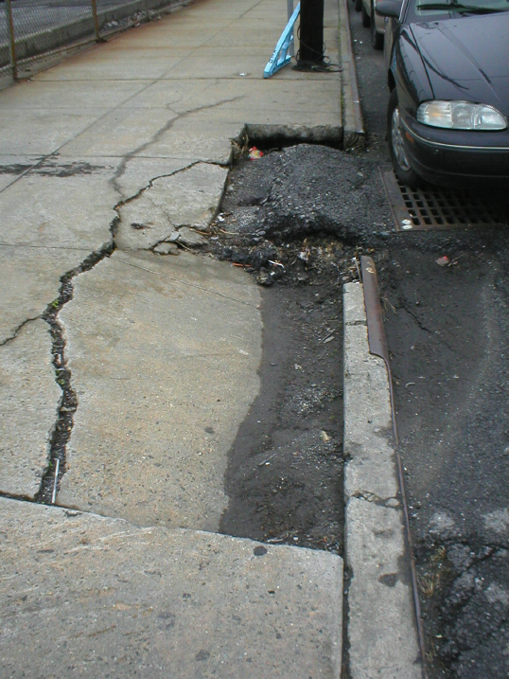
STF Risk Factor 10 – Unusual features
Distractions
  Alarms/buzzers
  Strobe/flashing lights
  Heavy pedestrian traffic
  Signs and attractive displays
  Decorations
  Strobe lights
  Sales displays
  Art work
Notes:
Unusual features are anything out of the ordinary that might distract a person walking through the area. Unusual features reflect the impact of distractions. Examples include distractions by a particular process, alarms/buzzers, strobe lights or flashing lights, high pedestrian traffic, unusually close proximity to material handling equipment, signs, information boards, displays, large windows, and decorative lighting.
Areas where unusual features are a major distraction should be rated appropriately. It is important to ensure that there are no other risk factors converging in this immediate area to increase the chance of a slip, trip or fall incident.
Unusual features can be anything that can distract someone from concentrating on what they are doing. A great example would be a group of site seeing tourists looking at art or sculptures in a crowded museum. Steps, bollards, benches, wheel stops, speed bumps, defects in walking surfaces or other obstructions may not be noticed, causing some of the tourists to trip, misstep or strike into in the items causing serious injury.
Permission to use picture.
You can use the pictures.
-----Original Message-----
From: Kelly Brown [mailto:kelly.brown@zurichna.com]
Sent: Tuesday, December 08, 2009 9:10 AM
To: Shana Velez
Subject: RE: Permission to Use Riverdale Pictures
Shana:
No. Your company would not be identified.
Kelly

Slide 21
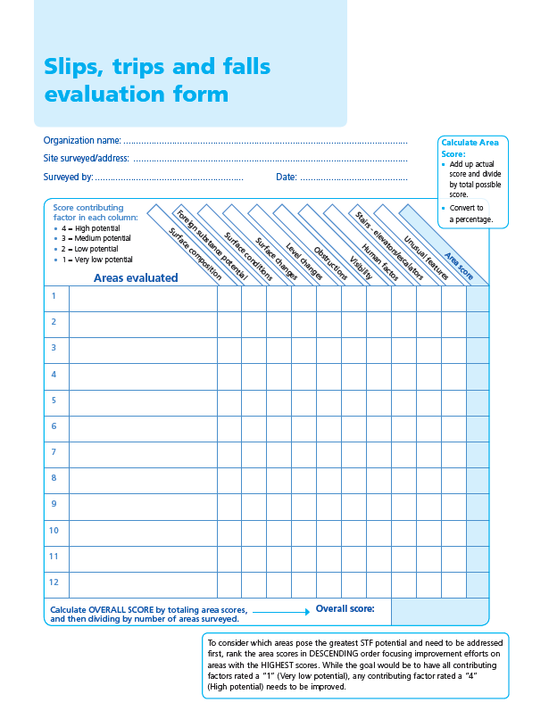
Using the evaluation guide
Fill out required information at top of slips, trips and falls evaluation form
Identify areas you will be evaluating; list in left column
Assess each area in relation to each contributing factor; If factor not present, do not score; Leave blank
  Be honest in your evaluation
  Take photos of areas evaluated and areas of concern. Barricade or place warning signs in areas identified with significant defects that need immediate action

Slide 22
Using the evaluation guide
Score each contributing factor based on the potential exposure(s) present that could contribute to a slip, trip and fall
  High potential = “4”
  Moderate potential = “3”
  Low potential = “2”
  Very low potential = “1”
Notes:
Assess each area in relation to each contributing factor. (Show “Contributing factor analysis and Contributing factor guide”). As indicated before, you will score each contributing factor as follows:
High potential = “4”
Moderate potential = “3”
Low potential = “2”
Very low potential = “1”

Slide 23
Using the evaluation guide
Total scores for each area evaluated
Use results to determine action plan and corrective measures
Possible controls include:
  Physical changes
  Administrative changes
Notes:
To calculate the area score, total up the actual score for the row and divide by the total possible score for the row. List your finding under the “Area Score”. (If all contributing factors are scored for a given row, a total of 100 percent would be the possible score for that row. If only 9 of 10 contributing factors were scored, the possible score for that row would still be 100 percent.)
Once you have completed surveying all the areas at the site, you can calculate an overall score by totaling up the area scores and dividing by the number of areas evaluated. List that number as the “Overall Score”.
To consider which areas pose the greatest STF potential and need to be addressed first, rank the area scores in descending order focusing improvement efforts on areas with the highest exposure scores. A self-calculating tool is available with each industry 10-point program. The tool will complete all of the calculations described. A second tab provided with the self-calculating tool will rank each area evaluated based on identified exposures.
When reviewing each area’s contributing factor score, the goal would be to have all contributing factors rated a “1” (Very low potential). If any contributing factor is rated a “4” (High potential), improvements need to be considered.
If you have evaluated multiple sites, you can use the same ranking approach to prioritize which sites you would focus improvement efforts on first by ranking each site’s overall score.

Slide 24
Physical changes
Examples include:
  Repair deficiencies in floor surfaces and railings
  Replace slippery when wet surfaces with surfaces having adequate asperities or roughness
  Test topical floor coatings that add asperities or consider etching to enhance slip resistance
  Install grab bars and rails where appropriate
  Avoid furnishings or decorations that might slip when leaned upon
  Use color contrasts to make steps or other level changes more visible
  Improve lighting
Notes:
When looking to make physical changes the following example items could be considered:
Repair deficiencies in floor surfaces and railings
Replace slippery when wet surfaces with surfaces having adequate asperities or roughness
Test topical floor coatings that add asperities or consider etching to enhance slip resistance
Install grab bars and rails where appropriate
Avoid furnishings or decorations that might slip when leaned upon
Use color contrasts to make steps or other level changes more visible
Improve lighting

Slide 25
Administrative changes
Administrative changes could include the following items:
  Development of a written self inspection program
  Complete staff slip, trip and fall prevention awareness training
  Complete walking/working surface risk assessment to determine coefficient of friction / slip resistance of current surfaces
  Test potential walking surfaces prior to purchase
  Train decision makers on slip resistance basics
Notes:
Administrative changes could include the following items:
Development of a written self inspection program
Complete staff slip, trip and fall prevention awareness training
Complete walking/working surface risk assessment to determine coefficient of friction/slip resistance of current surfaces
Test potential walking surfaces prior to purchase
Train decision makers on slip resistance basics

Slide 26
Administrative changes (continued)
Ensure managers, supervisors and employees are aware of their responsibility for fall prevention.
Identify visitors or employees who might be a high risk for falls due to lack of knowledge, unfamiliarity with the area, or physical limitations.
Cover fall prevention topics with employees during employment training and weekly/monthly meetings.
Include fall prevention items on routine self-inspection forms.
Ensure corrective action is assigned to a responsible person for correction and follow-up is conducted by management.
Notes:
Administrative changes-Continued.
Ensure managers, supervisors and employees are aware of their responsibility for fall prevention
Identify visitors or employees who might be a high risk for falls due to lack of knowledge, unfamiliarity with the area, or physical limitations
Cover fall prevention topics with employees during employment training and weekly/monthly meetings
Include fall prevention items on routine self-inspection forms
Ensure corrective action is assigned to a responsible person for correction and follow-up is conducted by management

Slide 27
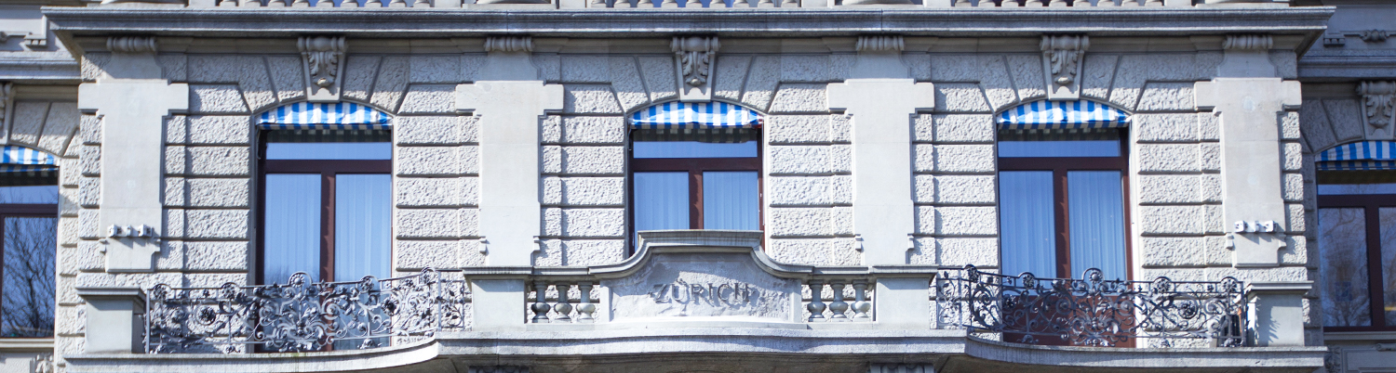
Tribometry

Slide 28
Who Falls
The At-Risk Population
  Ambulatory deficits (Gait dynamics)
  Physiologically &/or Neurologically impaired
  Demanding tasks (loaded, turning, velocity)
  Perceptive deficits (inherent or induced through distraction)
Physical fitness reduces the potential for and impact of a STF
  Recovery (muscles over power mass)
  Wellness

Slide 29
Phases of Human Ambulation – (Walking)
The Gait Cycle:
  Push Off – highest traction requirement
  Swing Phase
    interruption results in trip
    ¼” max vertical change in elevation
    Swing leg is traveling 2X the walking speed
  Heel contact
    Reduces swing leg speed to zero
    Initial contact approximately 30 degrees
    Constant smooth application of force after

Slide 30
Defining the Hazard
Slips & Slip Resistance
Slips: result from inadequate friction on the shoe/floor interface
  Remember surface asperities
  Water – the most common contaminant
  Hydrodynamic squeeze film, build up of contaminant between surface and shoe “hydroplaning”, where foot is momentarily supported by the film not the surface.
      Slip resistance of the surface become irrelevant
      Some surfaces disperse water better than others
  Traction demand based on the need of the person and activity
Slide Recovery (Near Miss)
  Requires neurological and physiological response for recovery
  Creep-arrest on the English XL Meter
The most effective means of reducing S&F’s: make floor slip resistant
  Surface roughness dictates slip resistance: ‘almost’, it’s the sharpness of the asperities

Slide 31
Engineering Principles
Methodologies related to walkway and footwear safety
  Floor surfaces* (XL quantify slip resistance, before & after)
    Smooth, shiny, hard surfaces vs. carpet
    Floor surface treatments (epoxy, etching, mats, metals)
  Contaminant on floors* (XL quantify effectiveness of housekeeping)
    Water – the leading cause of slips
    Chemicals/debris & housekeeping
  Footwear*
    Slip resistant shoes (Shoes for Crews)
    Shoe program (Evaluations/reimbursement)
    Special exposures (Snow/Ice)
  Gait dynamics (not controllable)
  *Controllable
Notes:
smooth, shiny, hard surfaces (reflective) present the most risk. Marble, granite that is polished. Carpet is the best alternative when possible
Epoxy coating, etching, mats, runners, slip-not metal products. XL can evaluate effectiveness of CA measures.
Floor contamination – proper cleaning, housekeeping, SPO’s. XL can evaluate effectiveness of cleaning procedures.

Slide 32
Required Slip Resistance
.25 to .35 min amount of traction required to for straight line unloaded walking at normal speed. Peak is at toe-off
.5 is a margin of safety, most people can walk on surfaces with slip index of < than .3 (thus it’s not the overall traction of the floor)
It’s usually a localized spot slipperier than other areas that causes the slip
STF Trivia: What is the slip resistance of ice?

Slide 33
Standards for Testing
Wet & Dry Testing (all withdrawn, available for sale)
ASTM F1677, Brungraber MK II (PIAST)
ASTM F1679, English XL (VIT)
ANSI A1264.2, “Provision of Slip Resistance in the Workplace”
Dry Testing
ASTM609, HPS
ASTM C1028, HPD (Horizontal Pull Dynamometer with 50 lb)
ASTM D2047, James Machine (test floor polishes)
UL 410, UL std for rating materials, James Machine

Slide 34
Other Standards
ANSI A1264.2-2 2001 “Std for the Provision of Slip Resistance on Walking/Working Surfaces
ASTM F1637-02, “Standard Practice for Safe Walking Surfaces”
ANSI A117, “Accessibility of Facilities to the Handicapped”
NFPA 1901, “Standard for Automotive Apparatus”
ASTM F2508, "Standard Practice for Validation and Calibration of Walkway Tribometers Using Reference Surfaces". The F2508 Standard Practice establishes a methodology to assure the precision and repeatability of walkway tribometers.

Slide 35
When to Utilize Tribometry
Design phase
Identify the slip resistance for problem areas
Quantify the effectiveness of cleaning efforts
Quantify the improvement in slip resistance for floor surface modifications
Claims/investigative process

Slide 36
Friction and Adhesion
Friction is the resistance to motion along the surfaces of two objects in contact with one another
Adhesion is when one material sticks to another
  Mechanical (velcro)
  Dispersive (Van Der Waals)
  Diffusive (polymerization)
Traction comes from friction and friction from adhesion. Asperities play a key role in this process and can be counteracted by contaminants.

Slide 37
Available Slip Resistance
Walkway Surface Texture
  Abrasive
  Embossed
  Carpet
Asperities
  Sharpness and Roughness
  Height & Frequency
  Must take contaminant depth into consideration
  Affected by:
    Cleaning, Wear, Installation practices
Smooth, hard shiny surfaces are dangerous when wet. The reflection is a tell tale sign of a slippery surface!

Slide 38
Asperity Types
Sharp and prominent
Smoothed
Etched
Worn

Slide 39
STF Resources
Zurich’s 10 Point STF Program (Not the only carrier or consultants with this capability)
Excel Tribometers – Excellent resource for training and the XL Tribometer
Pedestrian Slip Resistance – How to Measure It and How to Improve it by William English
Slip, Trip, and Fall Prevention – A Practical Handbook – Steven Di Pilla
NFSI/ANSI B101.1-2009 "Test Method for Measuring Wet SCOF of Common Hard-Surface Floor Materials“

Slide 40
Conclusion
Preventing slip, trip and fall incidents requires a multi-faceted approach.
Use the knowledge you gained today to advance your organization’s approach.
Ensure defects are identified and corrected as soon as possible.
If you are uncertain as to the slip resistance that is provided with your current walking/working surfaces, have them evaluated by a Zurich professional.
Undergoing a remodel or starting a new construction project, consider installing safer walking and working surfaces.
Notes:
Preventing slip, trip and fall incidents requires a multi-faceted approach. Use the knowledge you gained today to advance your organization’s approach. Ensure defects are identified and corrected as soon as possible. If you are uncertain as to the slip resistance that is provided with your current walking/working surfaces, have them evaluated by a Zurich professional. Undergoing a remodel or starting a new construction project, consider installing safer walking and working surfaces.

Slide 41
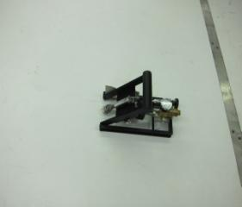
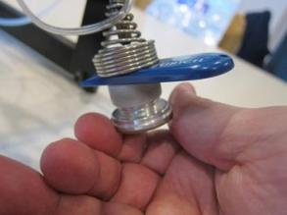
English XL Variable Incidence Tribometer (VIT)

Slide 42
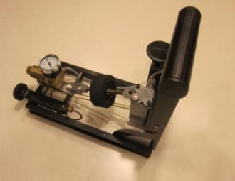
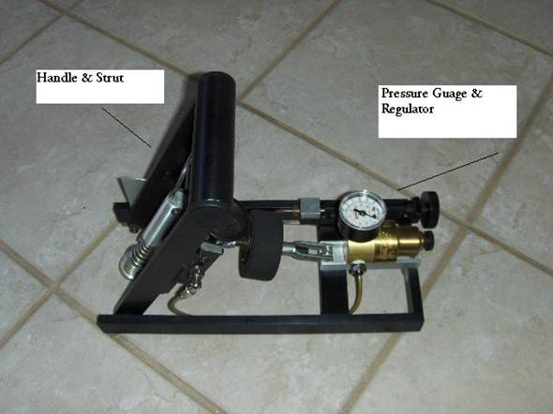
English XL Tribometer

Slide 43
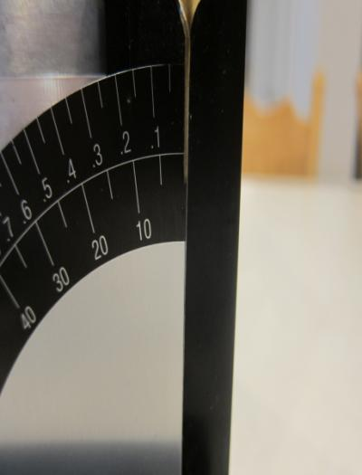
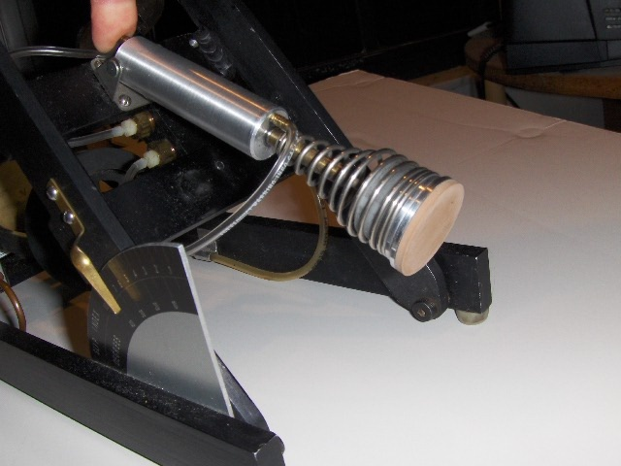
English XL Tribometer

Slide 44
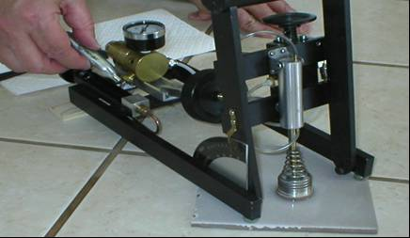
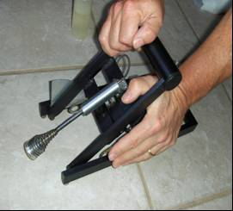
English XL Tribometer

Slide 45
© 2011 Zurich Services Corporation. All rights reserved.
The information in this publication and presentation was compiled by Zurich Services Corporation from sources believed to be reliable. Further, all sample policies and procedures herein should serve as a guideline which you can use to create your own policies and procedures. We trust that you will customize these samples to reflect your own operations and believe that these samples may serve as a helpful platform for this endeavor. Any and all information contained herein is not intended to constitute legal advice and accordingly, you should consult with your own attorneys when developing programs and policies. We do not guarantee the accuracy of this information or any results and further assume no liability in connection with this publication and presentation and sample policies and procedures, including any information, methods or safety suggestions contained herein. Moreover, Zurich Services Corporation reminds you that this cannot be assumed to contain every acceptable safety and compliance procedure or that additional procedures might not be appropriate under the circumstances. The subject matter of this publication and presentation is not tied to any specific insurance product nor will adopting these policies and procedures ensure coverage under any insurance policy.

